Slide 1

AI-Powered Movie Recommendation System
Presented by:
Evgeniya Englert
Codelabs Academy - DSFT 0725
February 3rd, 2026
Notes:
🎥 “What Should I Watch Next?”
Building an AI System That Knows Your Taste
Hook:
Every click, rating, and watch tells a story — this project turns that story into personalized recommendations.
Slide 1: The Business Case
Time: ~40 Seconds
Vibe: Strategic & Result-Oriented
The Problem (0:00-0:10): "In the streaming world, content is infinite, but user attention is a scarce resource. When users can't find what they love instantly, they churn. That’s a direct hit to revenue."
The Solution (0:10-0:25): "Our AI-Powered Recommendation System isn't just a technical exercise; it’s a retention engine. By optimizing collaborative filtering, we drive longer sessions and higher conversion rates—turning passive browsers into loyal subscribers."
The Edge (0:25-0:40): "We’ve also integrated an LLM to solve the 'cold algorithm' problem. Instead of robotic lists, we deliver personalized messages that make users feel valued. It’s strategic differentiation that moves the needle from 'just another app' to a premium user experience."
Key Phrases to Punch:
"Retention engine": Use this to frame the tech as a money-maker.
"Cold algorithm": Use this to highlight why the LLM is necessary for a "human" feel.

Slide 2

Objectives
Develop a High-Performance Movie Recommendation Engine
Deliver human-like personalization
using AI
Deploy a real, end-to-end machine learning system
Notes:
🎯 Project Objectives
Develop a High-Performance Movie Recommendation Engine
Design and evaluate multiple collaborative filtering approaches to identify the most accurate and computationally efficient model for personalized movie recommendations.
Enhance Personalization and User Engagement
Integrate a Large Language Model (LLM) to transform recommendation outputs into natural, personalized messages that improve user satisfaction and trust.
Deliver a Scalable End-to-End Recommendation Pipeline
Build a complete data science workflow—from raw data ingestion to API-based recommendation delivery—using industry-standard evaluation metrics and deployment practices.
Message:
This is not just a model — it’s a production-ready ML pipeline.

Slide 3

Business Problem: Engagement Needs Empathy
Our Ideal Movie
Streaming platforms can recommend movies — but they struggle to make users feel understood. With endless content, users disengage when recommendations feel generic or algorithmic. The real challenge is not what to recommend, but how it’s communicated.
Our solution: Deliver the best possible recommendations, enhanced with empathic, personalized language that:
Makes users feel personally valued
Builds trust and emotional connection
Drives longer sessions and higher engagement
Recommending with empathy.
Notes:
Business Problem—Engagement Needs Empathy
Time: 30 Seconds
Vibe: Persuasive & Human-Centric
The Problem (0:00-0:10): "Streaming platforms are great at processing data, but they’re failing at the human element. When recommendations feel like a generic list from a robot, users disengage."
The Shift (0:10-0:20): "The challenge isn't just what to recommend—it’s how we communicate it. We are moving beyond cold math to deliver recommendations with empathy."
The Payoff (0:20-0:30): "By using an LLM to personalize the 'why' behind a movie, we build emotional connection and trust. This isn't just a better UX; it’s a strategy to drive longer sessions and turn users into loyal fans."

Slide 4

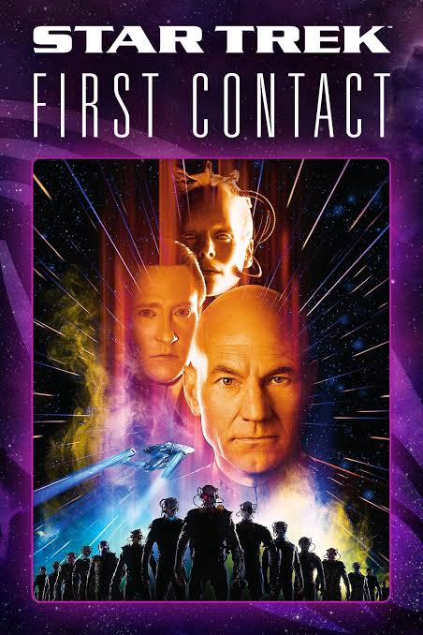
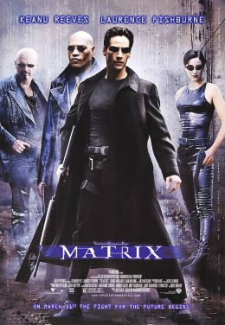
ML Task: Personalized Movie Recommendation
Example Recommendations
LLM Personalized Message
“Hey there! As a college student like you, I know you're always on the move and could use a mind-bending break. I've got just the thing!
Dive into the deep end of imagination with "The Matrix" (1999). This action-packed Sci-Fi thriller will keep you on your toes and leave you questioning reality.
Or, if intergalactic adventures are more your style, "Star Trek VI: The Undiscovered Country" (1991) offers a mix of action, adventure, and thought-provoking themes that'll make you feel like the captain of your own journey.
And don't forget about "Star Trek: First Contact" (1996), another thrilling Sci-Fi adventure that's perfect for when you need an escape from the stresses of student life.
🌟 Enjoy the ride! 🚀🍿”
Notes:
ML Task Chosen
Personalized Movie Recommendation
Why it’s powerful:
High business impact
Real-world complexity
Perfect fit for collaborative filtering

Slide 5
Methodological Deep Dive

Slide 6

The Architecture: Data Science Meets Empathy
Data Ingestion
MovieLens 1M dataset processing:
6,040 users
3,900 movies
1M ratings
Preprocessing
Cleaning data and building the User-Item Matrix
Core Engine
Compared 6 approaches for Collaborative Filtering.
Selected User-Based CF with Cosine Similarity (5-fold stratified cross-validation)
LLM Personalization
Ollama API generates personalized human-sounding messages based on demographics
Deployment
Final output served
via FastAPI
Notes:
Data Foundation (0:00-0:10): "Our pipeline begins with the MovieLens 1M dataset.
We process over a million ratings into a User-Item Matrix to identify patterns in how 6,000+ users interact with nearly 4,000 films.“
Why this dataset?
Industry benchmark
Large-scale & realistic
Ideal for collaborative filtering
The Engine (0:10-0:25): "After testing six different approaches, focusing on accuracy, speed, scalability, we selected User-Based Collaborative Filtering with Cosine Similarity.
It was the clear winner, delivering a Recall@10 of 0.8358 and an F1-Score of 0.3414. Most importantly, it's fast—processing folds in just 27 seconds."
The Empathy Layer (0:25-0:40): "We then pass these results to the Ollama API, where a pre-trained LLM acts as our personalization layer. It fuses the movie titles with user demographics to write a friendly, 2-3 sentence message. This turns a standard list into a conversation."
Final Delivery (0:40-0:45): "The entire process is served via FastAPI, ensuring a low-latency, end-to-end user experience."

Slide 7
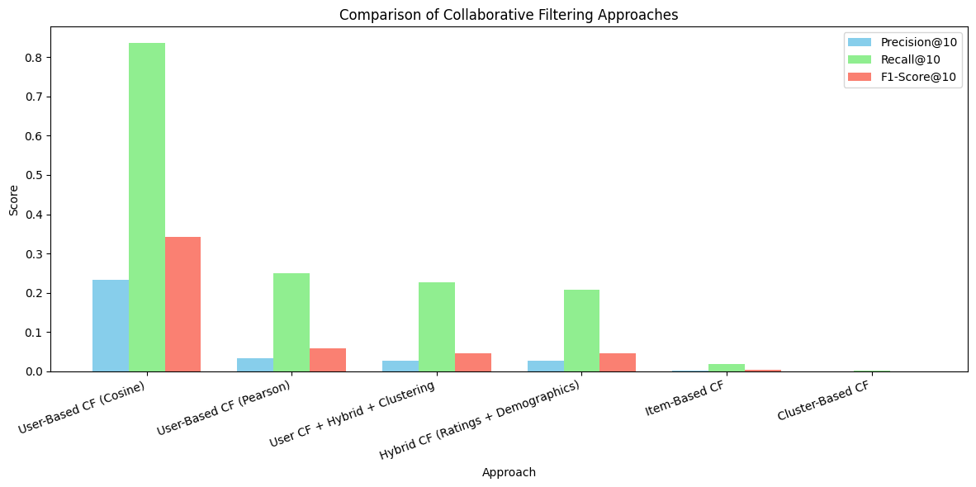
Recommendation Methods Evaluated
Notes:
I evaluated 6 CF approaches using 5-fold cross-validation and the metrics:
Metric
Description
Goal
Precision@10
• Predictive accuracy: Proportion of top-10 recommended movies that are relevant
• Minimize not relevant recommendations
Recall@10
• Sensitivity: Proportion of relevant movies retrieved in top-10 recommendations
• Maximize coverage of user interests
F1-Score@10
• Harmonic mean of Precision@10 and Recall@10
• Quantify the harmonic trade-off between predictive precision and retrieval sensitivity.

Slide 8
User-Based CF is the Winner!
CF Approach | Outcome | Success Metric (F1-Score)
User-Based (Cosine) | Winner: Best balance of precision and speed. | 34%
User-Based (Pearson) | Rejected: Too slow for real-time (~2.13 hrs). | 5.75%
Hybrid (Ratings + Demo) | Cold-Start Solution: Effective for new users. | 4.63%
Hybrid (Heatmap) | Analysis Only: High complexity in automation. | 4.68%
Item-Based | Rejected: High latency (~4.4 hrs). | 0.33%
Cluster-Based | Rejected: Poor quality due to over-generalization. | 0.04%
Notes:
The Goal (0:00-0:10): "We didn't just pick a model—we ran a 'bake-off' to see which algorithm actually met our business needs for speed and accuracy.“
📊 Evaluation Metrics
Precision@10 – Are recommendations relevant?
Recall@10 – Are we finding enough good movies?
F1@10 – Balanced performance
Validation:
5-Fold Cross-Validation for robustness
The Result (0:10-0:25): "The results were stark. While most models struggled to break 6% accuracy or took hours to run,
our User-Based Cosine model achieved a 34% F1-Score. It wasn't just the most accurate; it was also the most efficient, processing data in seconds."
The Bottom Line (0:25-0:30): "This model gives us the high-quality, real-time suggestions our users expect.“
Key takeaway:
The best production model is the smartest and the fastest: best F1, strong recall, practical execution time.

Slide 9
The Architecture: Data Science Meets Empathy
Data Ingestion
MovieLens 1M dataset processing:
6,040 users
3,900 movies
1M ratings
Preprocessing
Cleaning data and building the User-Item Matrix
Core Engine
Compared 6 approaches for Collaborative Filtering.
Selected User-Based CF with Cosine Similarity (5-fold stratified cross-validation)
LLM Personalization
Ollama API generates personalized human-sounding messages based on demographics
Deployment
Final output served
via FastAPI
Notes:
Data Foundation (0:00-0:10): "Our pipeline begins with the MovieLens 1M dataset.
We process over a million ratings into a User-Item Matrix to identify patterns in how 6,000+ users interact with nearly 4,000 films.“
Why this dataset?
Industry benchmark
Large-scale & realistic
Ideal for collaborative filtering
The Engine (0:10-0:25): "After testing six different approaches, focusing on accuracy, speed, scalability, we selected User-Based Collaborative Filtering with Cosine Similarity.
It was the clear winner, delivering a Recall@10 of 0.8358 and an F1-Score of 0.3414. Most importantly, it's fast—processing folds in just 27 seconds."
The Empathy Layer (0:25-0:40): "We then pass these results to the Ollama API, where a pre-trained LLM acts as our personalization layer. It fuses the movie titles with user demographics to write a friendly, 2-3 sentence message. This turns a standard list into a conversation."
Final Delivery (0:40-0:45): "The entire process is served via FastAPI, ensuring a low-latency, end-to-end user experience."

Slide 10
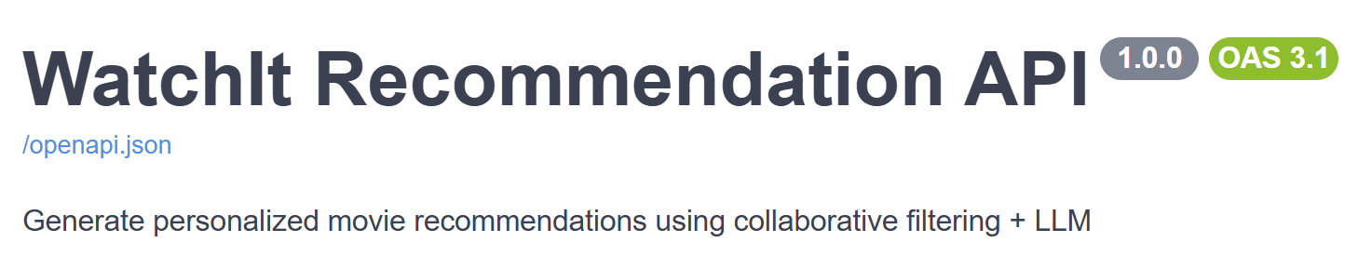
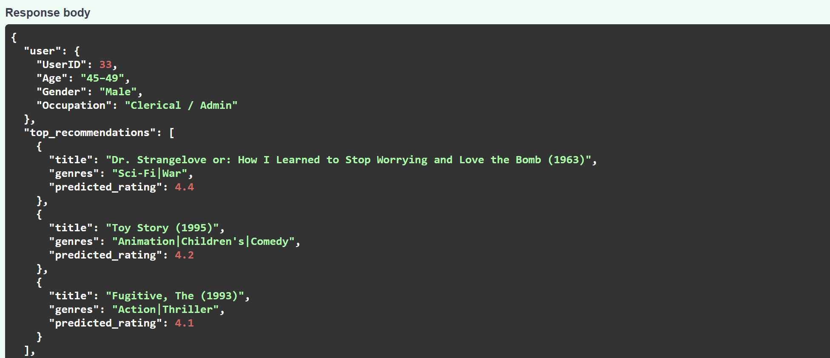
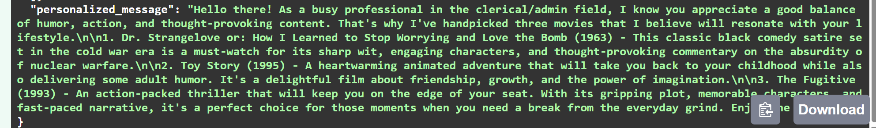
Deployment with FastAPI
Prompt
"You are a warm, friendly, and emotionally intelligent movie recommender for the platform WatchIt. Adapt tone and vocabulary to the user’s age. Naturally connect the user’s lifestyle or occupation to the mood or themes of the recommended genres. Write exactly 2–3 sentences, each on a new line. Use bullet points ONLY for the top 3 movie recommendations. Do not mention zip code."
Notes:
The Transition: "To maximize engagement, we’ve integrated a pre-trained LLM via the Ollama API to act as our personalization layer."
The Mechanism: "By feeding movie titles and user demographics into our custom-engineered prompts, the system generates natural, enthusiastic messages."
The Goal: "This transforms a cold algorithmic output into human-centered communication that makes every user feel personally valued."

Slide 11
Making AI Feel Human
Live Presentation

Slide 12


Deliverables & Next Steps
Final Deliverables
Strategic Next Steps
Trained ML Model: Selected User-Based Cosine
Personalization Layer: Integrated LLM via Ollama
Deployed API: Built on FastAPI for real-time use
Business & tech documentation incl. code on GitHib
Model Governance: Track quality and data drift
Continuous Optimization: Periodic retraining and prompt updates
Feature Expansion: Scalable cold-start implementation
Notes:
Reality check:
ML systems age — monitoring keeps them relevant.

Slide 13
Key Takeaways ✅
Built a real-world ML pipeline
User-Based CF (Cosine) performed best
Hybrid and clustering models aided analysis
Balances accuracy, speed, and personalization
LLM improves user experience
Deployed an AI system end-to-end
Combined ML + LLMs for better UX
Release Month by Revenue Category (Context: seasonality might be important for movie quality based on domain knowledge High quality/revenue movies might be released around Thanksgiving and Christmas)
This project mirrors how machine learning is built in industry.
Notes:
Authoritative & Future-Focused
Speaker Notes
The Core Logic (0:00-0:10): "This project isn't just a model; it's a mirror of how industry-grade machine learning is built today. We validated that User-Based Cosine Similarity remains the gold standard for balancing accuracy and speed."
The Unique Edge (0:10-0:20): "What makes this unique is the end-to-end integration of ML and LLMs. We didn't stop at raw predictions; we used an LLM to bridge the gap between cold data and human connection."
The Final Impact (0:20-0:30): "By deploying this entire pipeline via FastAPI, we’ve created a system that is fast, personalized, and built to solve the real-world challenge of user retention through empathy."

Slide 14
THANK YOU
Presented by:
Evgeniya Englert

Slide 15
Resources
Project Report: [Link]
Source Code & Technical Details: [GitHub]

Slide 16
$\rightarrow$
Collaborative Filtering Approaches
01.
02.
03.
User-Based (Cosine)
Finds nearest neighbors based on rating similarity
High Recall and F1-score
Balanced execution time
Selected as final model
User-Based (Pearson)
Adjusts rating bias but slow and low precision
Cluster-Based
Groups users into clusters by rating behavior
Recommendations generated within clusters
Fast but low accuracy
Notes:
“I didn't just pick a model; I conducted a rigorous 'bake-off' between six different approaches. While Cluster-Based methods were fast, they were too generic. On the other hand, Item-Based and Pearson models were computationally expensive, with some taking hours to run. Ultimately, User-Based Cosine Similarity emerged as our winner, giving us the precision we needed without sacrificing the performance our business goals require."

Slide 17
$\rightarrow$
Collaborative Filtering Approaches
04/05.
06.
Hybrid Models
Demographics and clustering added context but higher complexity
Item-Based
Computes movie similarity but very slow
Notes:
“I didn't just pick a model; I conducted a rigorous 'bake-off' between six different approaches. While Cluster-Based methods were fast, they were too generic. On the other hand, Item-Based and Pearson models were computationally expensive, with some taking hours to run. Ultimately, User-Based Cosine Similarity emerged as our winner, giving us the precision we needed without sacrificing the performance our business goals require."

